Slide 1

Chris Follows
University of the arts London
Mainstreaming grass roots innovation in open educational practice: benefits and challenges
ALT-C 2012 14 September 2012

Slide 2
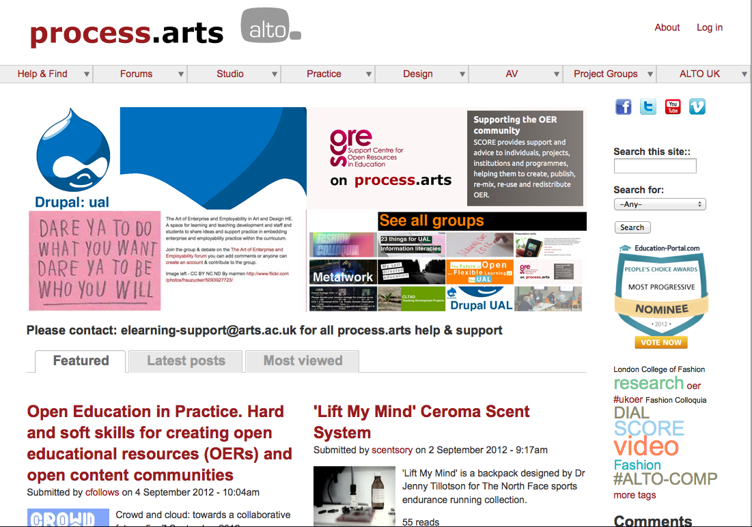
http://process.arts.ac.uk/

Slide 3
http://process.arts.ac.uk/
Open resource for sharing practice/knowledge and creating OERs.
Not course aligned, alternative VLE environment that encourages and supports rich media experimentation and informal learning.
Non-commercial but sector driven/owned.
Grass roots, innovation & agile development.
Open to everyone, staff & students: Global and local.
Straddles the institution/educational (formal learning) environment and the social (informal learning) environment.
Experimental’ space for open educational practitioners.
Defining a new language for open edu-social practice without conforming or being influenced by pre-existing academic structures and processes.
Informal learning.

Slide 4
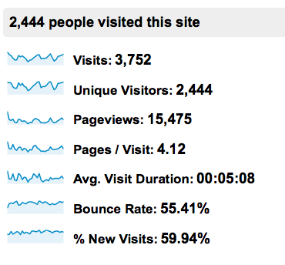
Participation May 2012
AVERAGE PER MONTH:
4k visitors a month.
2-3k unique visitors a month.
Below Analytics May 2012:
Logged in users = 362
All content posts = 1450.
Video direct = 195.
3rd Party video posts = 150.
Image/text/audio = 950.
Forum topics = 105.
Conversation:
Comments = 470.
Tags = Thousands.

Slide 5
Connectivity is king?
‘Content is not king’ (Andrew Odlyzko)
‘Despite the rhetoric of the content industry, the most valuable contribution to our economy comes from connectivity, not content. Content is the ginger in gingerbread—important, no doubt, but nothing like the most valuable component in the mix.’ (Remix: Making Art and Commerce Thrive in the Hybrid Economy. Lawrence Lessig)

Slide 6
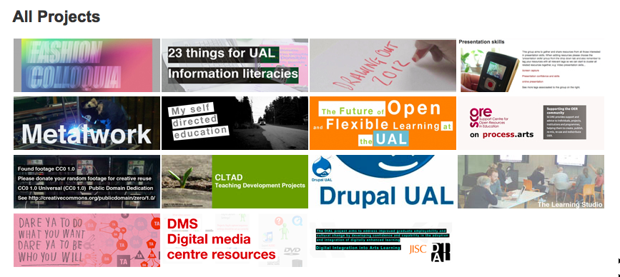
The specialist group sections have continued to develop and we now have 15 active groups. Once a community can commit and want to take 'ownership' of a specialist section we have develop this requirement appropriately.

Slide 7
Voluntary soft skills for creating OER & OEP communities
Digital Citizenship
Guidance
Global and local networks/communities
Respectful & open aware (content use & IPR)
Open practice mentor
Monitoring and supervision
Acknowledgment (is someone out there)
Stewardship

Slide 8
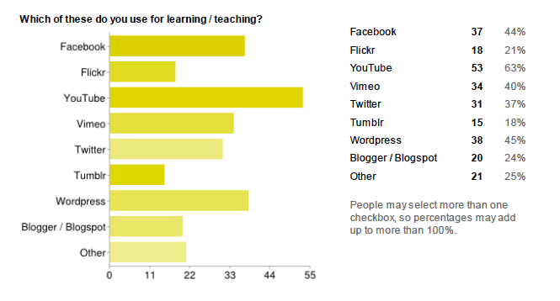
DIAL Surveys Your Digital World - please tell us more!

Slide 9
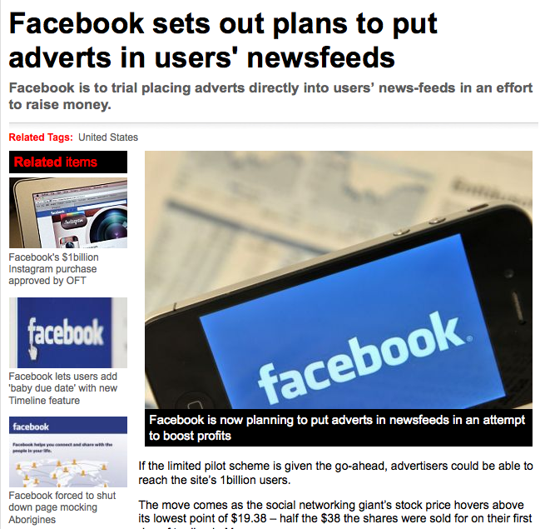

http://www.metro.co.uk/tech/908698-facebook-sets-out-plans-to-put-adverts-in-users-newsfeeds

Slide 10
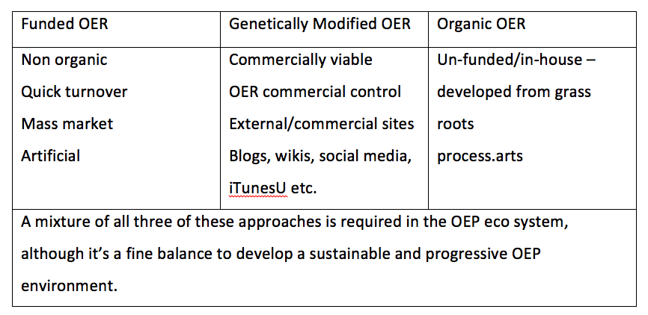
How do we create places for OER Rich media communities?

Slide 11
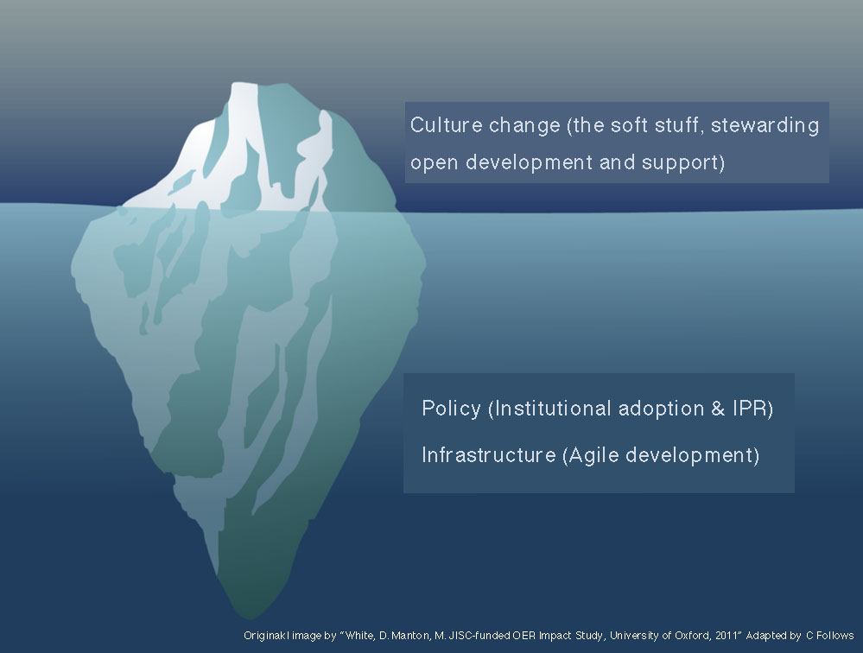
Transition into a service

Slide 12
Project plan System Documentation
Bugs - document current issues to be fixed and priority
See: http://process.arts.ac.uk/content/high-priority-bug-fix
Planned Features - document new features planned for PA
See - http://process.arts.ac.uk/forum/1894
Functional refinements - document required refinements for PA
User documentation - Create help files and help section for all areas of user support.
Admin documentation - Create a list of admin tasks, what's involved, user questions, support, content and comment moderation etc.

Slide 13
Project plan Code review, documentation and recommendations
Integration and testing
Moodle
Workflow (Mahara)
Filestore (edshare)
MyBlogs (Wordpress)
Future Development
Code fix
Migrate to Drupal 7
Code fix
Refine UI/UX
Plan training and support
Submit code to repository (live service)

Slide 14
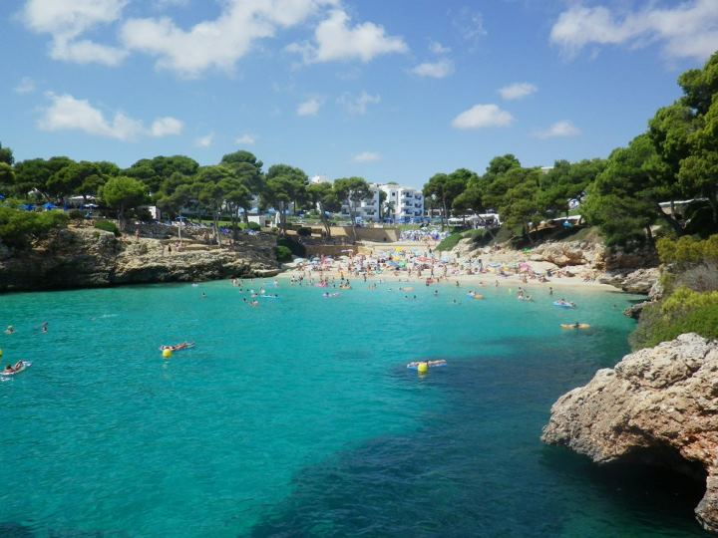
Benefits
Long term Institutional support
Long-term future
Stability
Improved service
Development plan (expand)
Institutional adoption & acceptance
On the agenda; inform policy, IPR, open agenda
A live case study

Slide 15

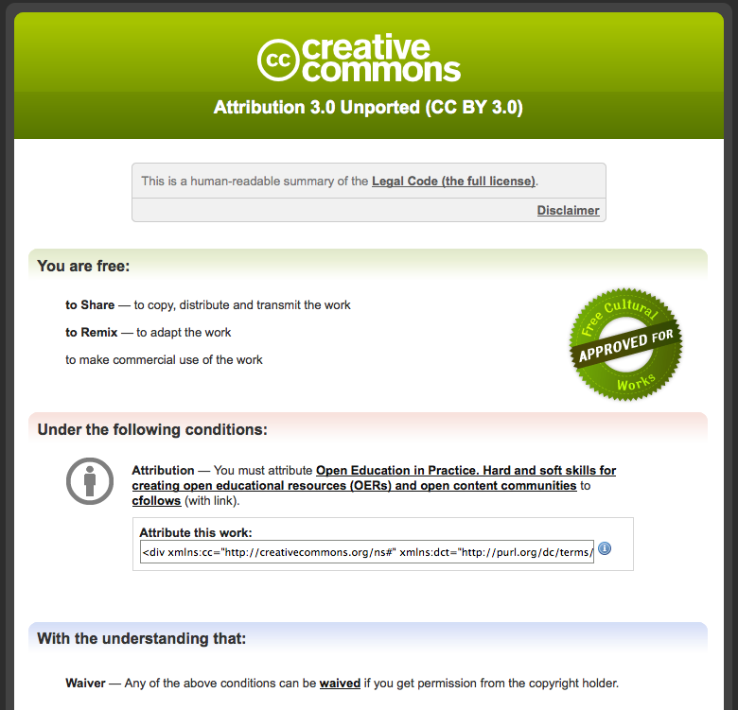
Support IPR policy and development for UAL open educational practice

Slide 16

Challenges
Lose independent spirit (institutional & commercial).
Slow progress (Institutional bureaucracy).
Maintain agile development (keep up).
Growth beyond the Institution.
Danger of having too close an affiliated.

Slide 17
Primary Challenge
Motivation to participate

Slide 18
Lodger
Visitor
Novice

Slide 19
Voluntary participation (Difficult)
What are the rewards? or
Compulsory participation (Easy & difficult)?
What are the rewards?
Compulsory e.g. part of the assessment
Dynamics

Slide 20
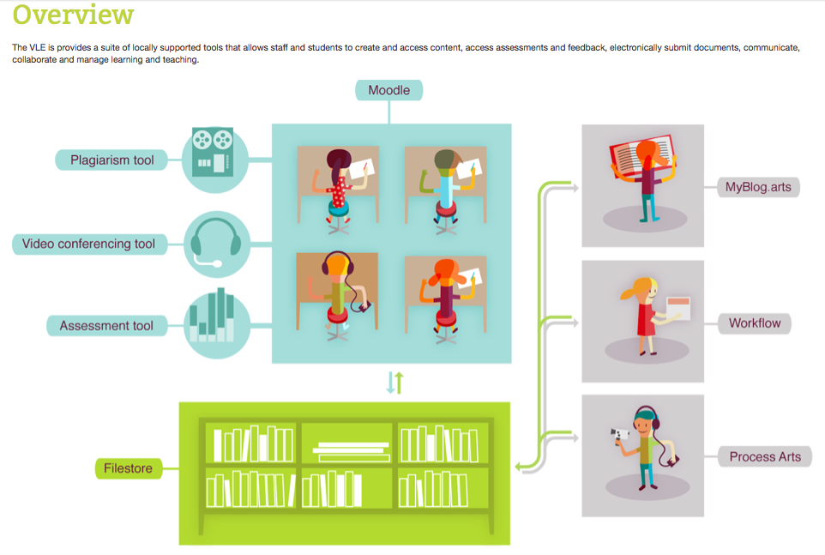
UAL new VLE portfolio

Slide 21
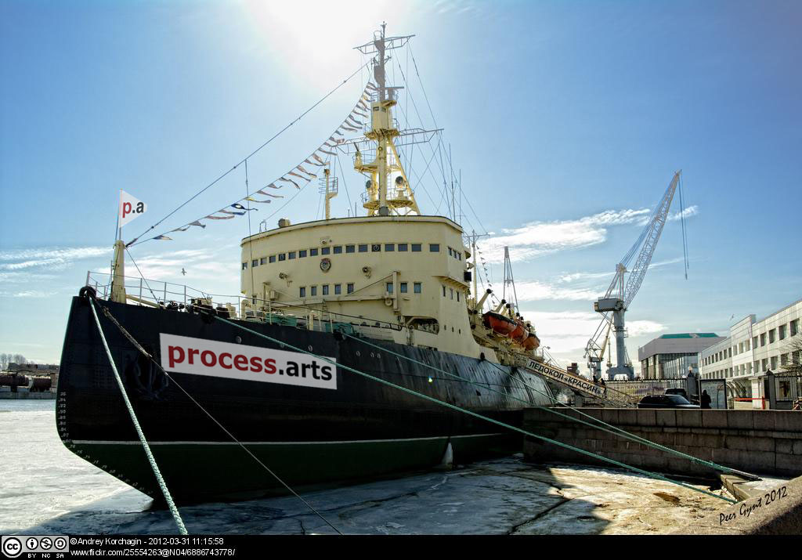
Thank you
Chris Follows
Email: c.follows@arts.ac.uk
University of the Arts London
272 High Holborn
London
WC1V 7EY
Mobile: 07703 887845

