Slide 1

DIALOGUE 02:
CCW Digital Enhancement staff development event
Chris Follows
Digital Learning Technologies Manager
CCW Learning, Teaching & Enhancement (LTE)

Slide 2
DIALOGUE 02:
14:00 Introduction & Focus group discussions
Online Learning & Teaching
Developing Digital Skills
Digital MakerSpaces
15:00 Focus group summary, Tea break & DigiTell setup
15:15 DigiTell session: A number of small informal group discussions (similar to learning studio ) share projects & practice
16:15: End & drinks reception

Slide 3
“We are at the forefront of the digital revolution, we’ll take everyone with us and won't leave anyone behind”

Slide 4
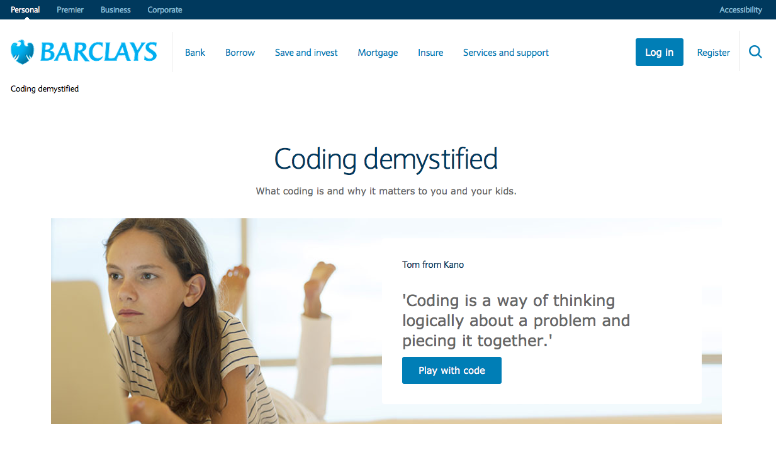
‘If Barclays can do it anyone can’
Barclays' Sara Bennison on the transformation being brought about by bringing
digital skills and confidence to the fore across various parts of
their business and the wider community.

Slide 5
If we cant get the basic right we stand no chance of progressing, all this talk about exciting digital change is great, but its all ‘Pie in the sky’

Slide 6
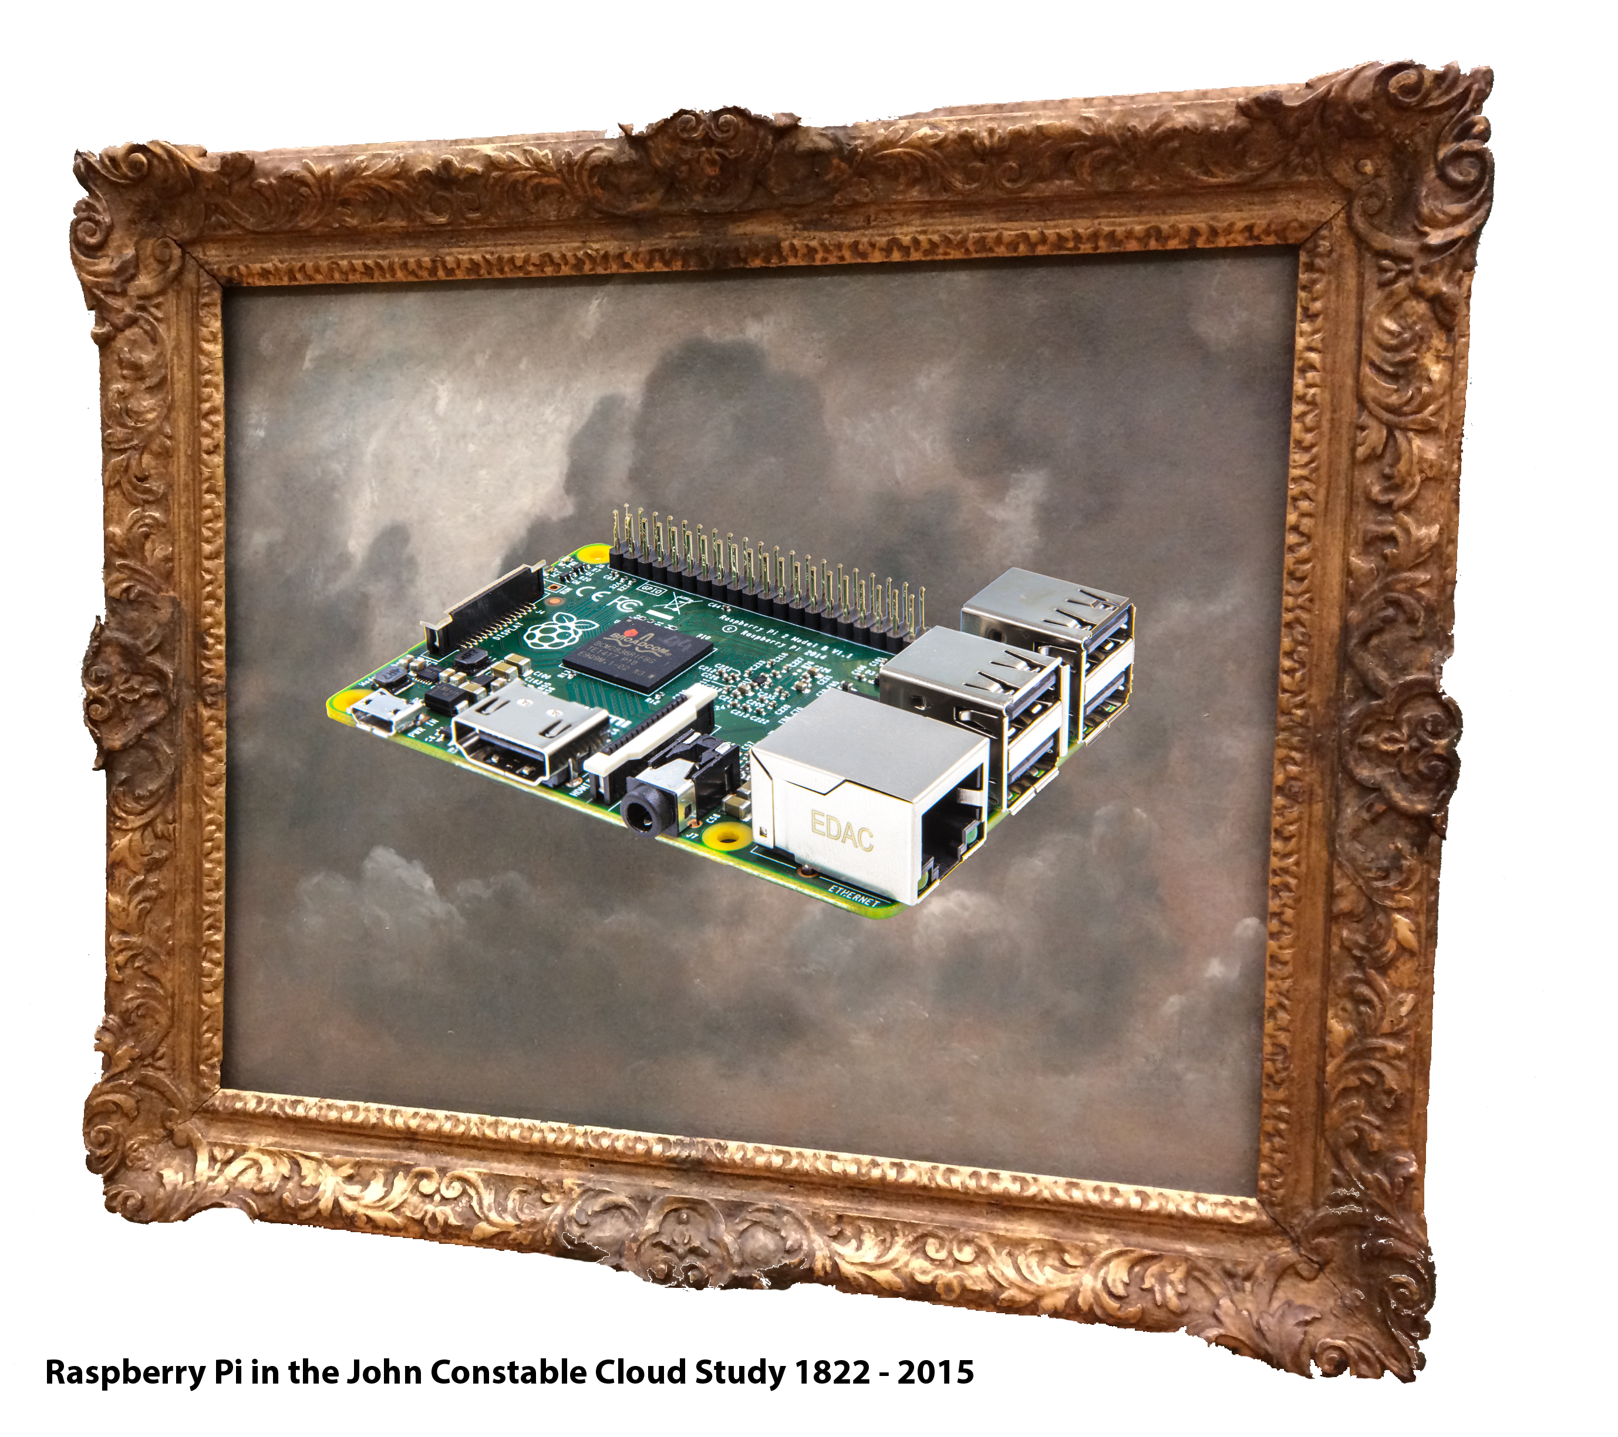
…. we need to keep moving forward

Slide 7
CCW/UAL priority:
Digital services, tools & processes
VLE, admin/digital tools, AV, printing, digital learning, resources, equipment, support, IT, training, spaces
I would like to meet with all teams to help identify and resolve issues, so please contact me & invite me to your team meetings
For this session lets please try & not get bogged down in too much of the details

Slide 8
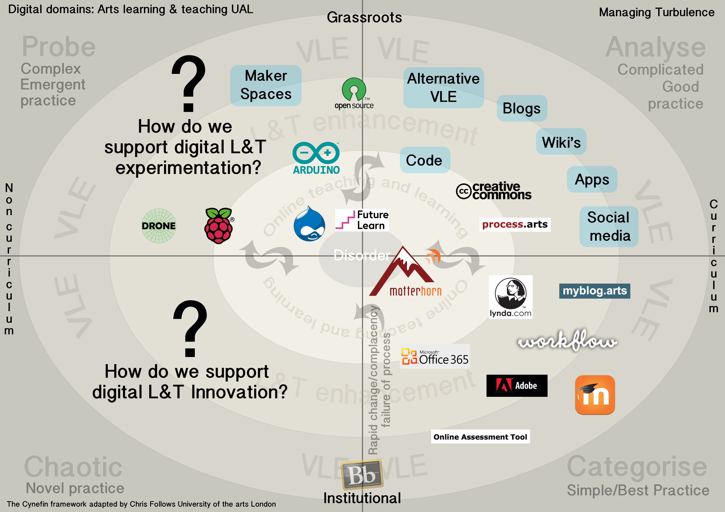
Considering the big picture

Slide 9
Three topics to explore together
Online Learning & Teaching
Developing Digital Skills
Digital MakerSpaces
Group discussion facilitators:
Dave White, Nancy Buabeng & David Webster

Slide 10
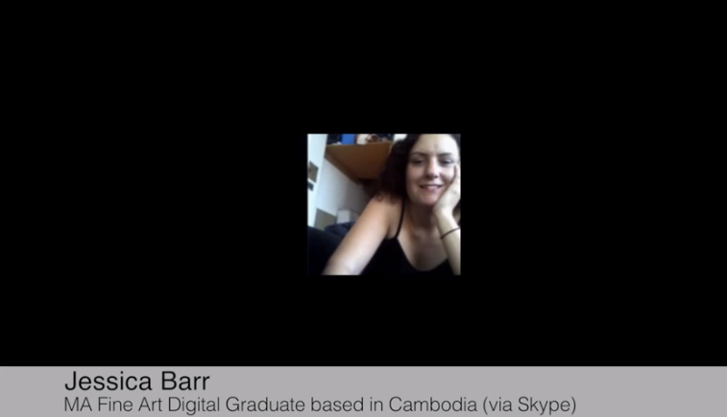
Online Learning & Teaching
Fully online Courses at CCW
“I don’t think digital is a medium, instead I think it’s a language which crosses mediums, creates new spaces and opportunities for artistic practice to happen”
Jonathan Kearney - Course Director | MA in Fine Art Digital at Camberwell, offered as a studio based course and an online course
CCW Short Courses are also exploring fully online courses

Slide 11
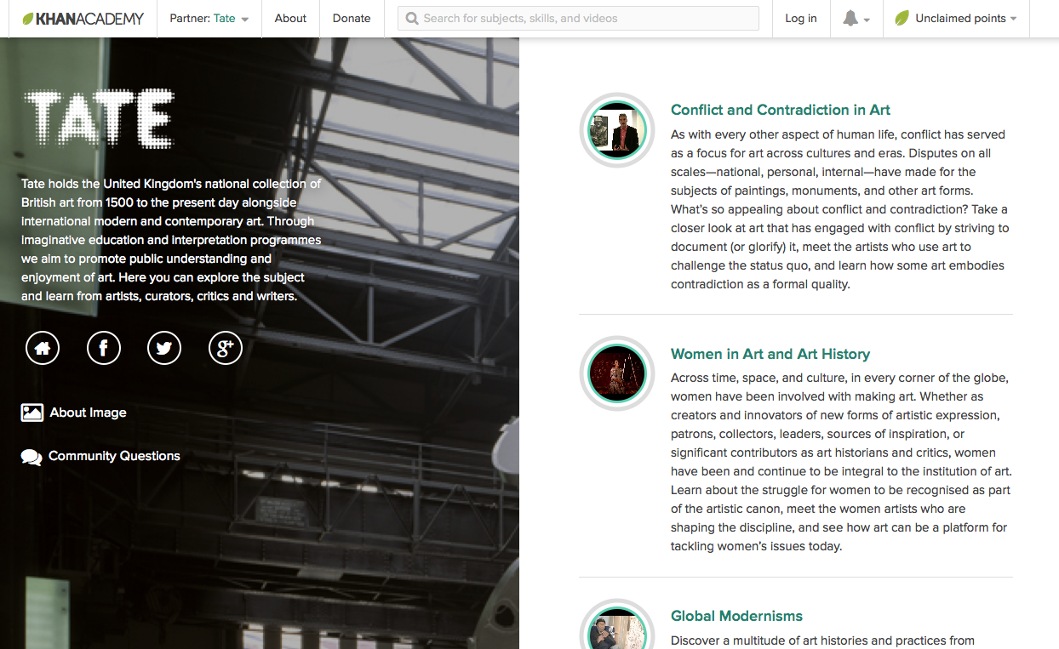
Online Learning & Teaching

Slide 12
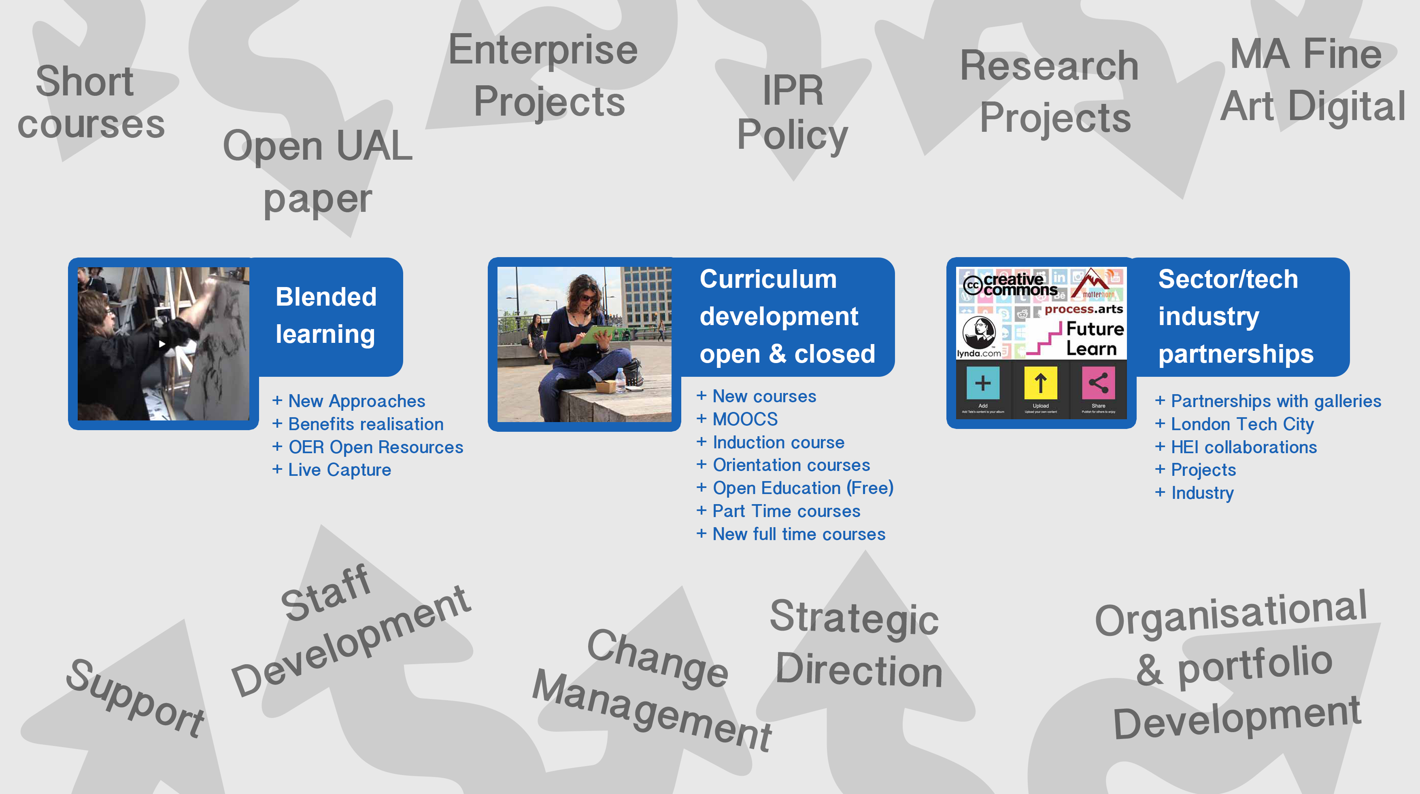
Online Learning & Teaching

Slide 13
Online Learning & Teaching
Group discussion:
How do you see ‘Online Learning’ affecting teaching and learning across CCW in the next five years?

Slide 14
Online Learning & Teaching
(how do we take everyone with us)
Recommendations:
What can you/we/individuals do to prepare, take ownership & be part of change?
What could CCW do to help us prepare & support change?

Slide 15
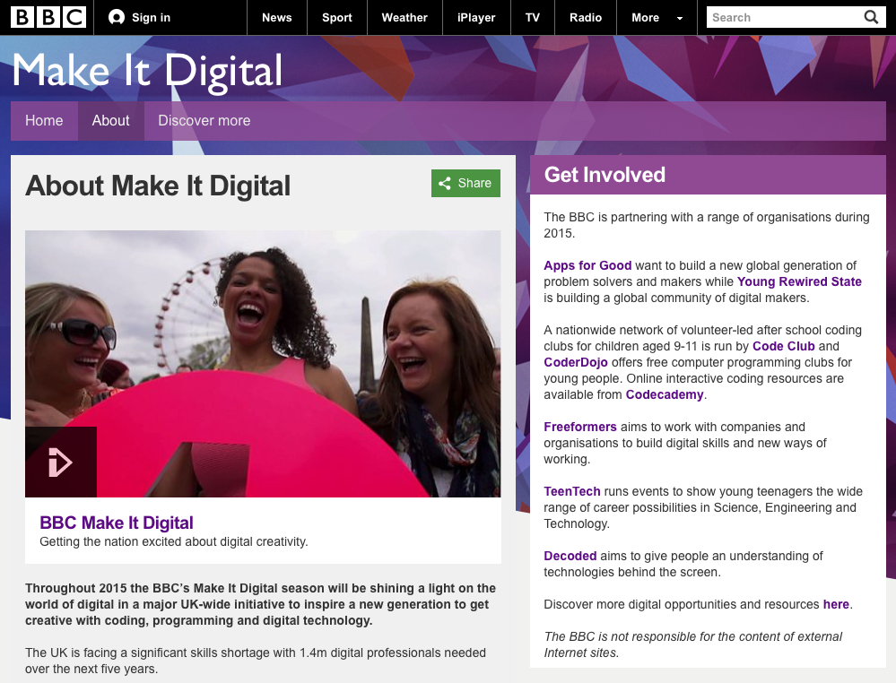
Developing Digital Skills
Joanna Wild & Dr Patricia Charlton | Creative Digital Solutions
Demo of the microbit being used in schools as part of the BBC Make It Digital work.

Slide 16
Developing Digital Skills
  Group discussion:
  Should we be rethinking our approach to developing digital skills, if so how?
  Recommendations:
  What can we/CCW do to help identify skills gaps and support new approaches in developing digital practice & expertise?

Slide 17
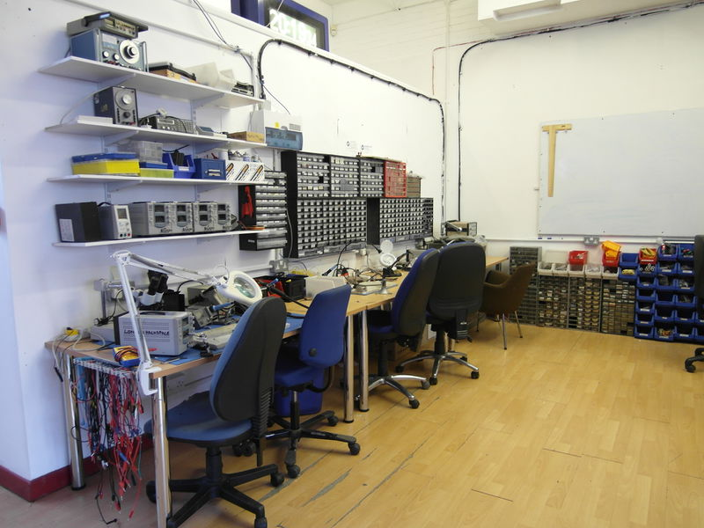
Digital MakerSpaces
London Hackspace Electronics Section

Slide 18
Digital MakerSpaces
“… I go to whichever MakerSpace has what I need for my practice:
…it has all the high tech & low tech tools I need close to hand…
…it has the expertise I need when I need it…
…it’s multi-disciplinary…
…but most of all it has a community, a peer network, we all help
each other, you enter it in that mindset, its not a service.”
WCA Fine Arts student talking about London Hackspace

Slide 19
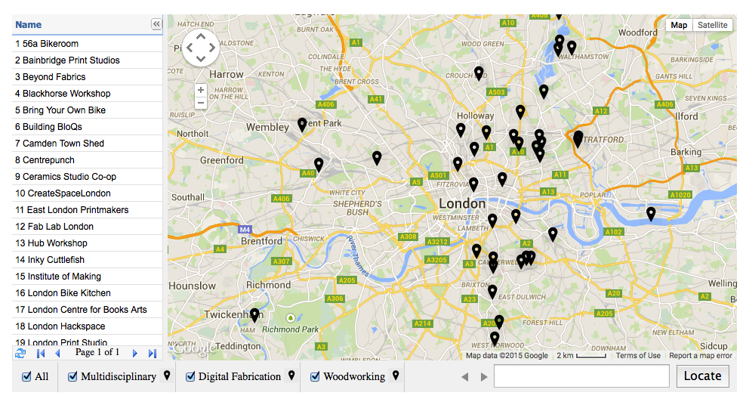
Digital MakerSpaces
The Open Workshop Network
A virtual repository of the open access facilities across London

Slide 20
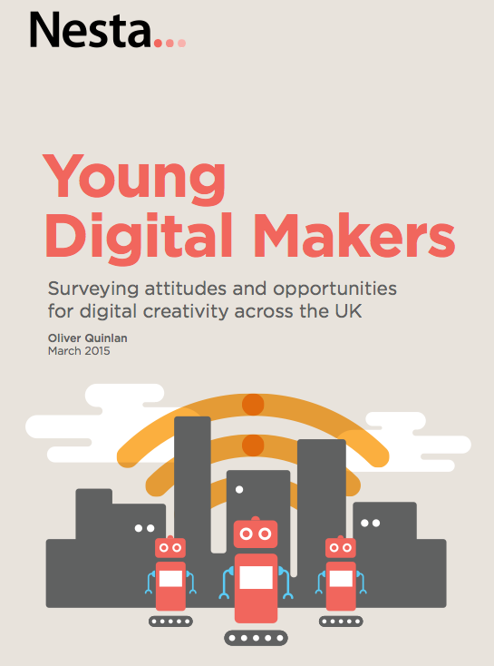
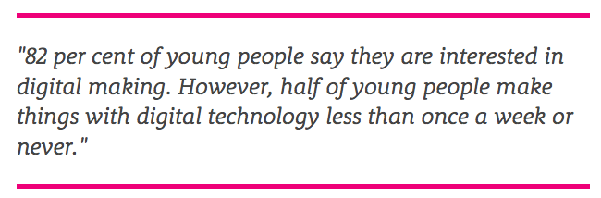
Digital MakerSpaces
How are we supporting
young digital makers?
See Nesta report

Slide 21
Digital MakerSpaces
  Group discussion & Recommendations:
  How should/could we be supporting students in these areas more?

Slide 22
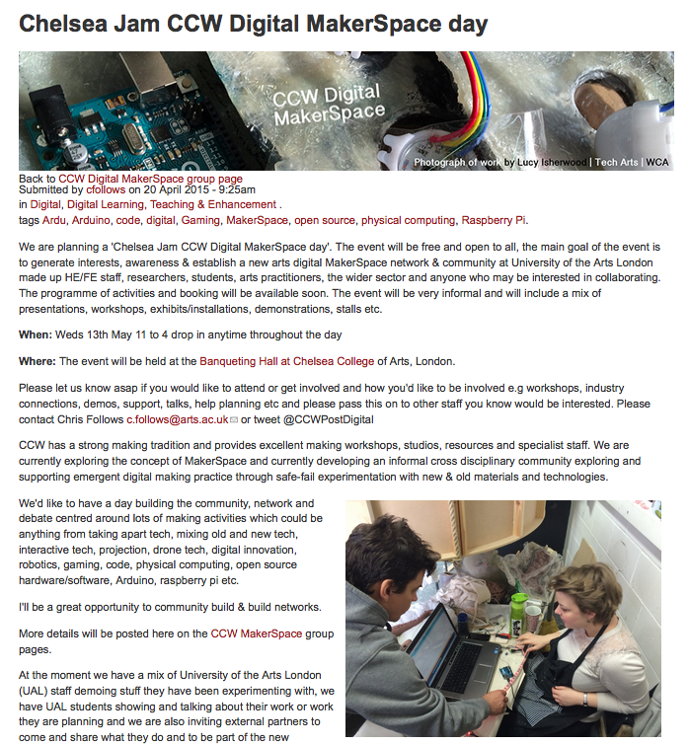

Slide 23
DigiTell session
Online Learning & Teaching
Natasha Bonnelame, Camille Gajewski & Mika Suetake | Tate Khan Academy
Ashleigh Pearson & Ameet Hindocha | A cross-disciplinary approach to teaching FE
Group discussion facilitator: Dave White
Developing Digital Skills
Ollie Furlong | Sharing LCF experiences of integrating ‘live capture’ & video streaming
Paul Thrippleton | Discussions around staff development and using online learning
Marie Kelly & Lucy Wright | Chance to find out about the new Office 365
Isabella Tasseff-Elenkoff | Using the IPad in workshop environments, archival & research
Group discussion facilitator: Nancy Buabeng
Digital MakerSpaces
Dr Patricia Charlton | Creative Digital Solutions, Demo of the microbit BBC work
Will Waterhouse & Grzesiek Sedek | Examples of traditional making skills & new tech (arduino)
Thanasis Velios | Open source software and the monopoly of commercial creative software
Group discussion facilitators: David Webster

