Slide 1
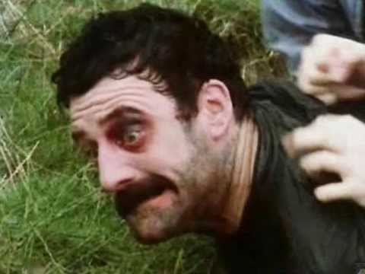


Online Collaborative Practice & WebMaking
Chris Follows
CCW Digital Learning Manager UAL
2nd May 2017
@CCWDigital CCWDigital

Slide 2
Gis' A Job
What are your motivations, and why?
What’s your current practice online?
What are the barriers?

Slide 3
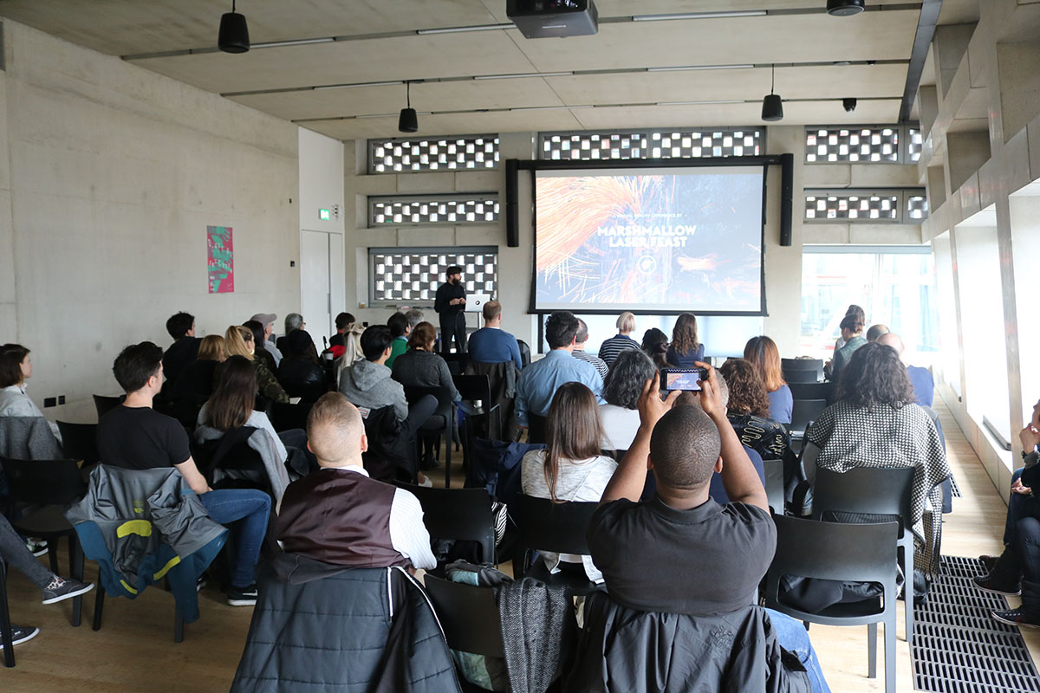
Making the most of what support
is out there

Slide 4
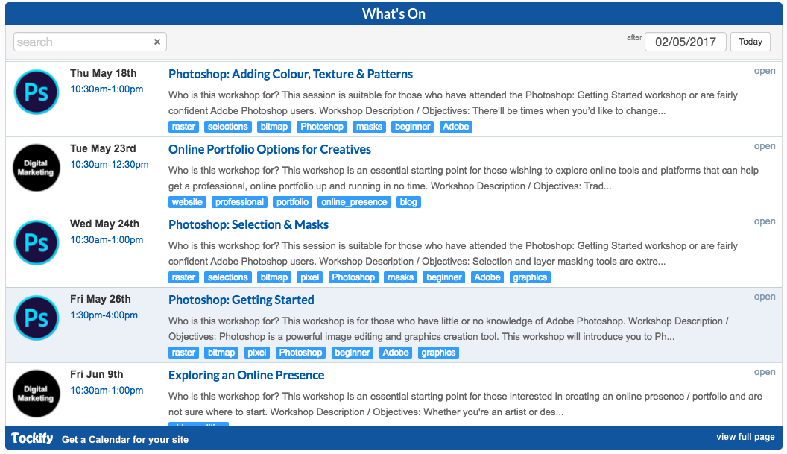
On-site college support

Slide 5
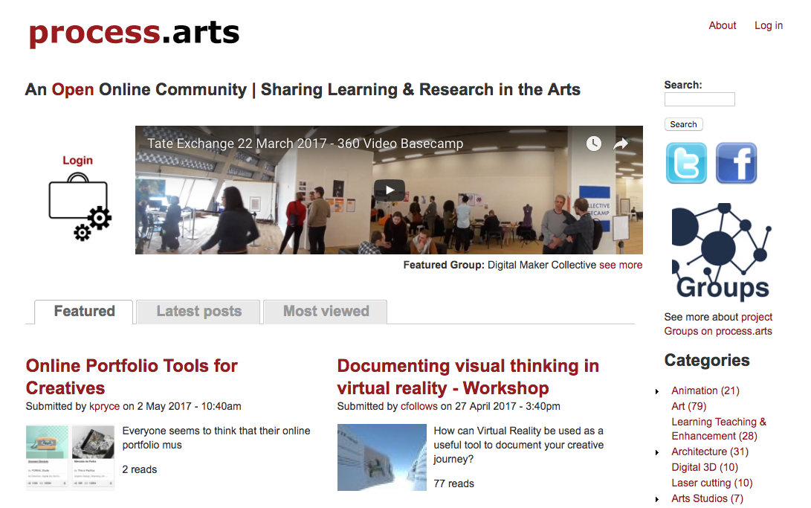
Lots of resources online

Slide 6
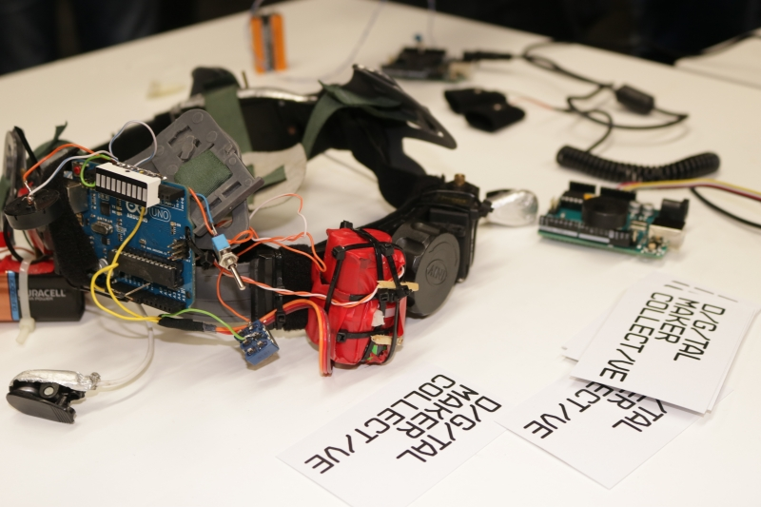
Learn Together

Slide 7
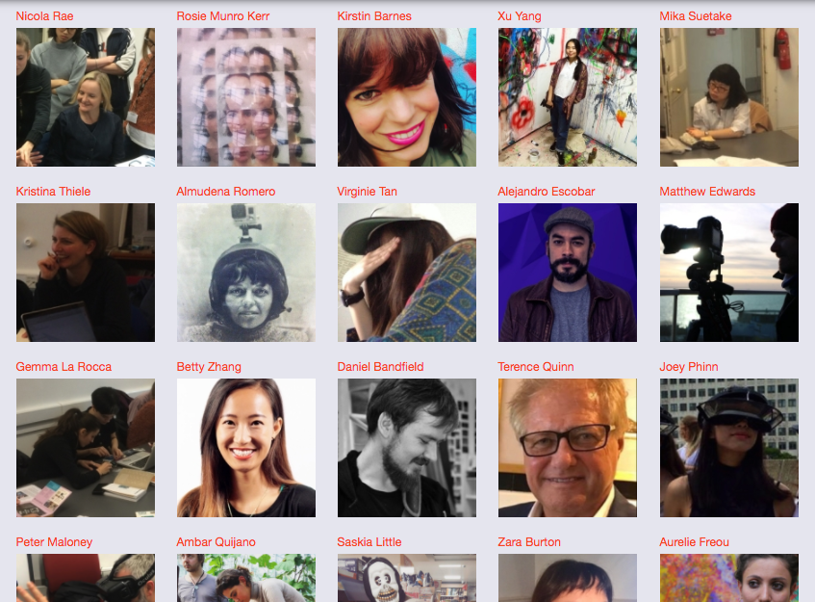
On & offline communities

Slide 8
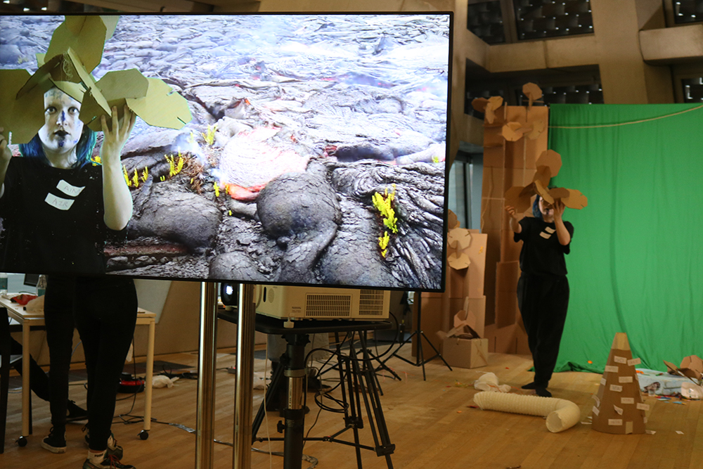
“I’ve learnt more about how to involve the public in highly
technological environments”

Slide 9
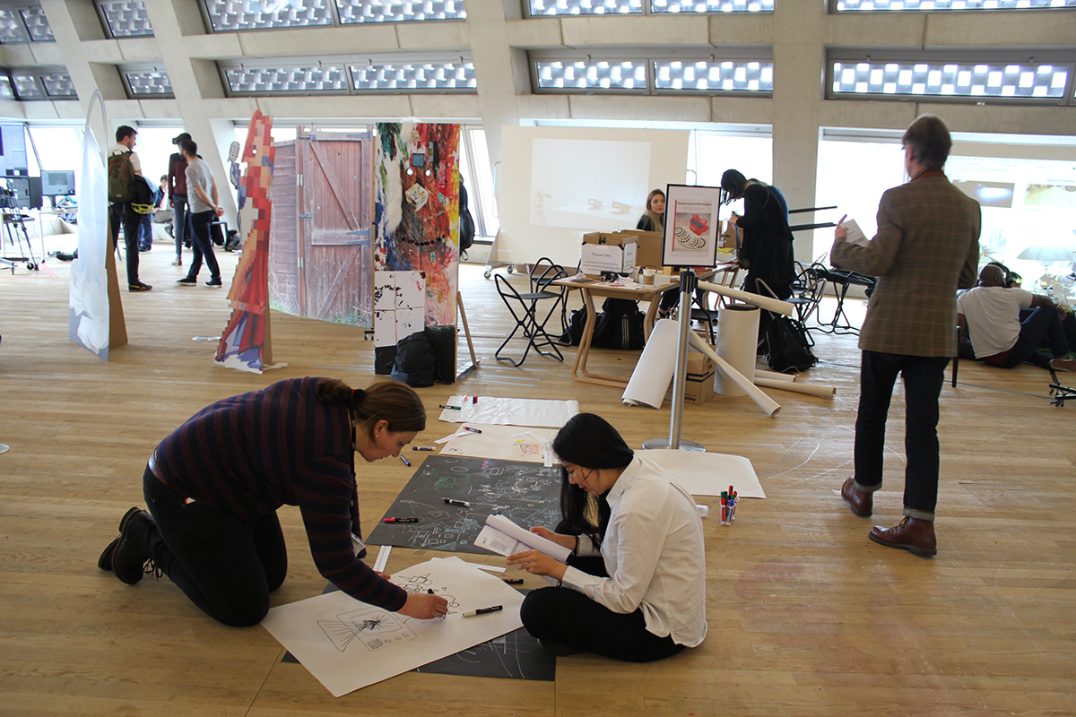
“I was able to challenge my Ideas”
”Curious to see how I could locate my practice in the new digital era”

Slide 10
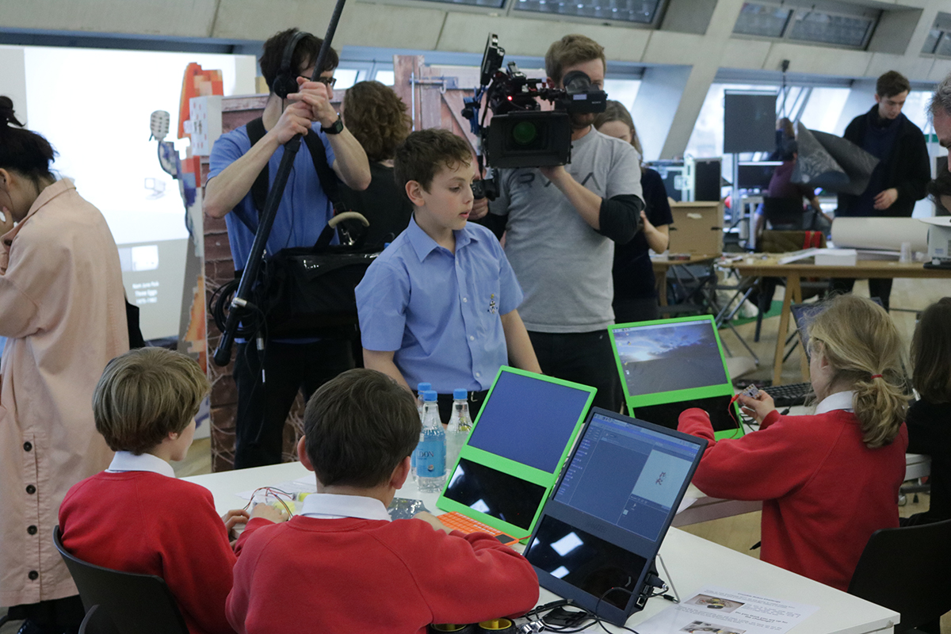
”Intense learning experience”
Visibility & Social Media Interest

Slide 11
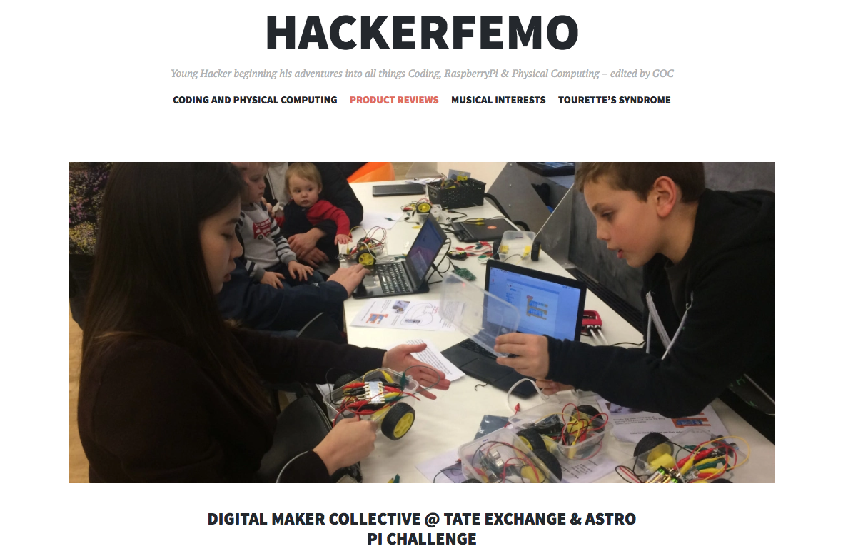
https://hackerfemo.com/

Slide 12
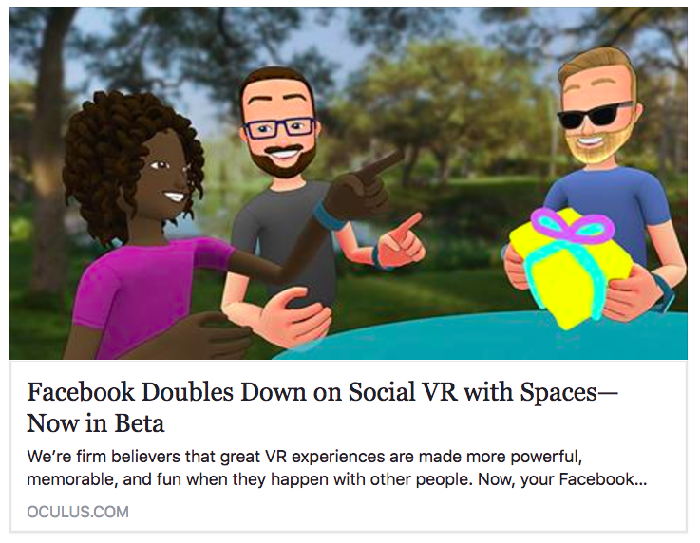
Beyond a website

Slide 13
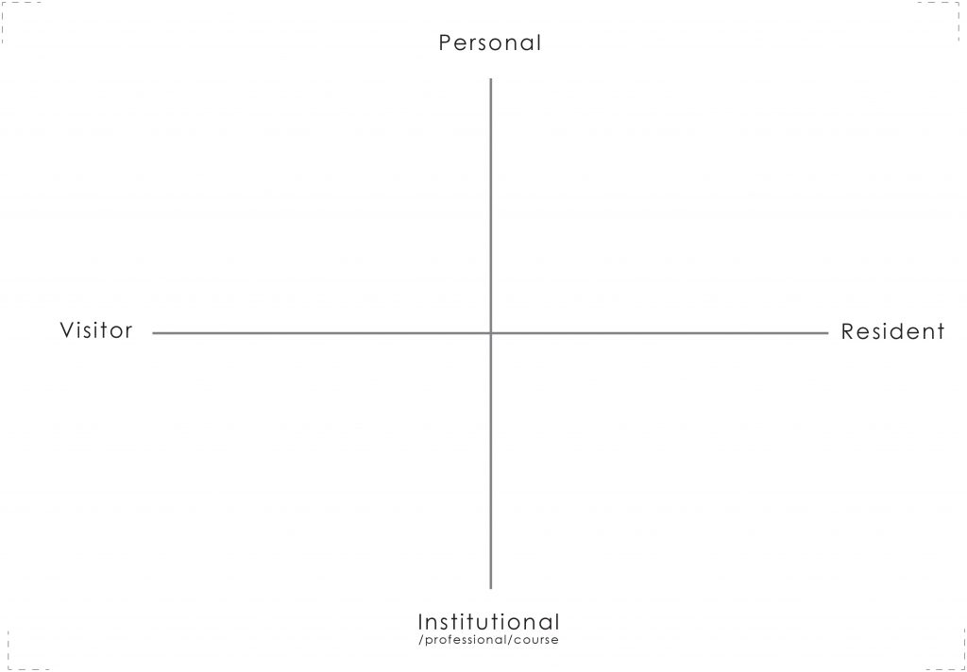
https://youtu.be/sPOG3iThmRI

Slide 14
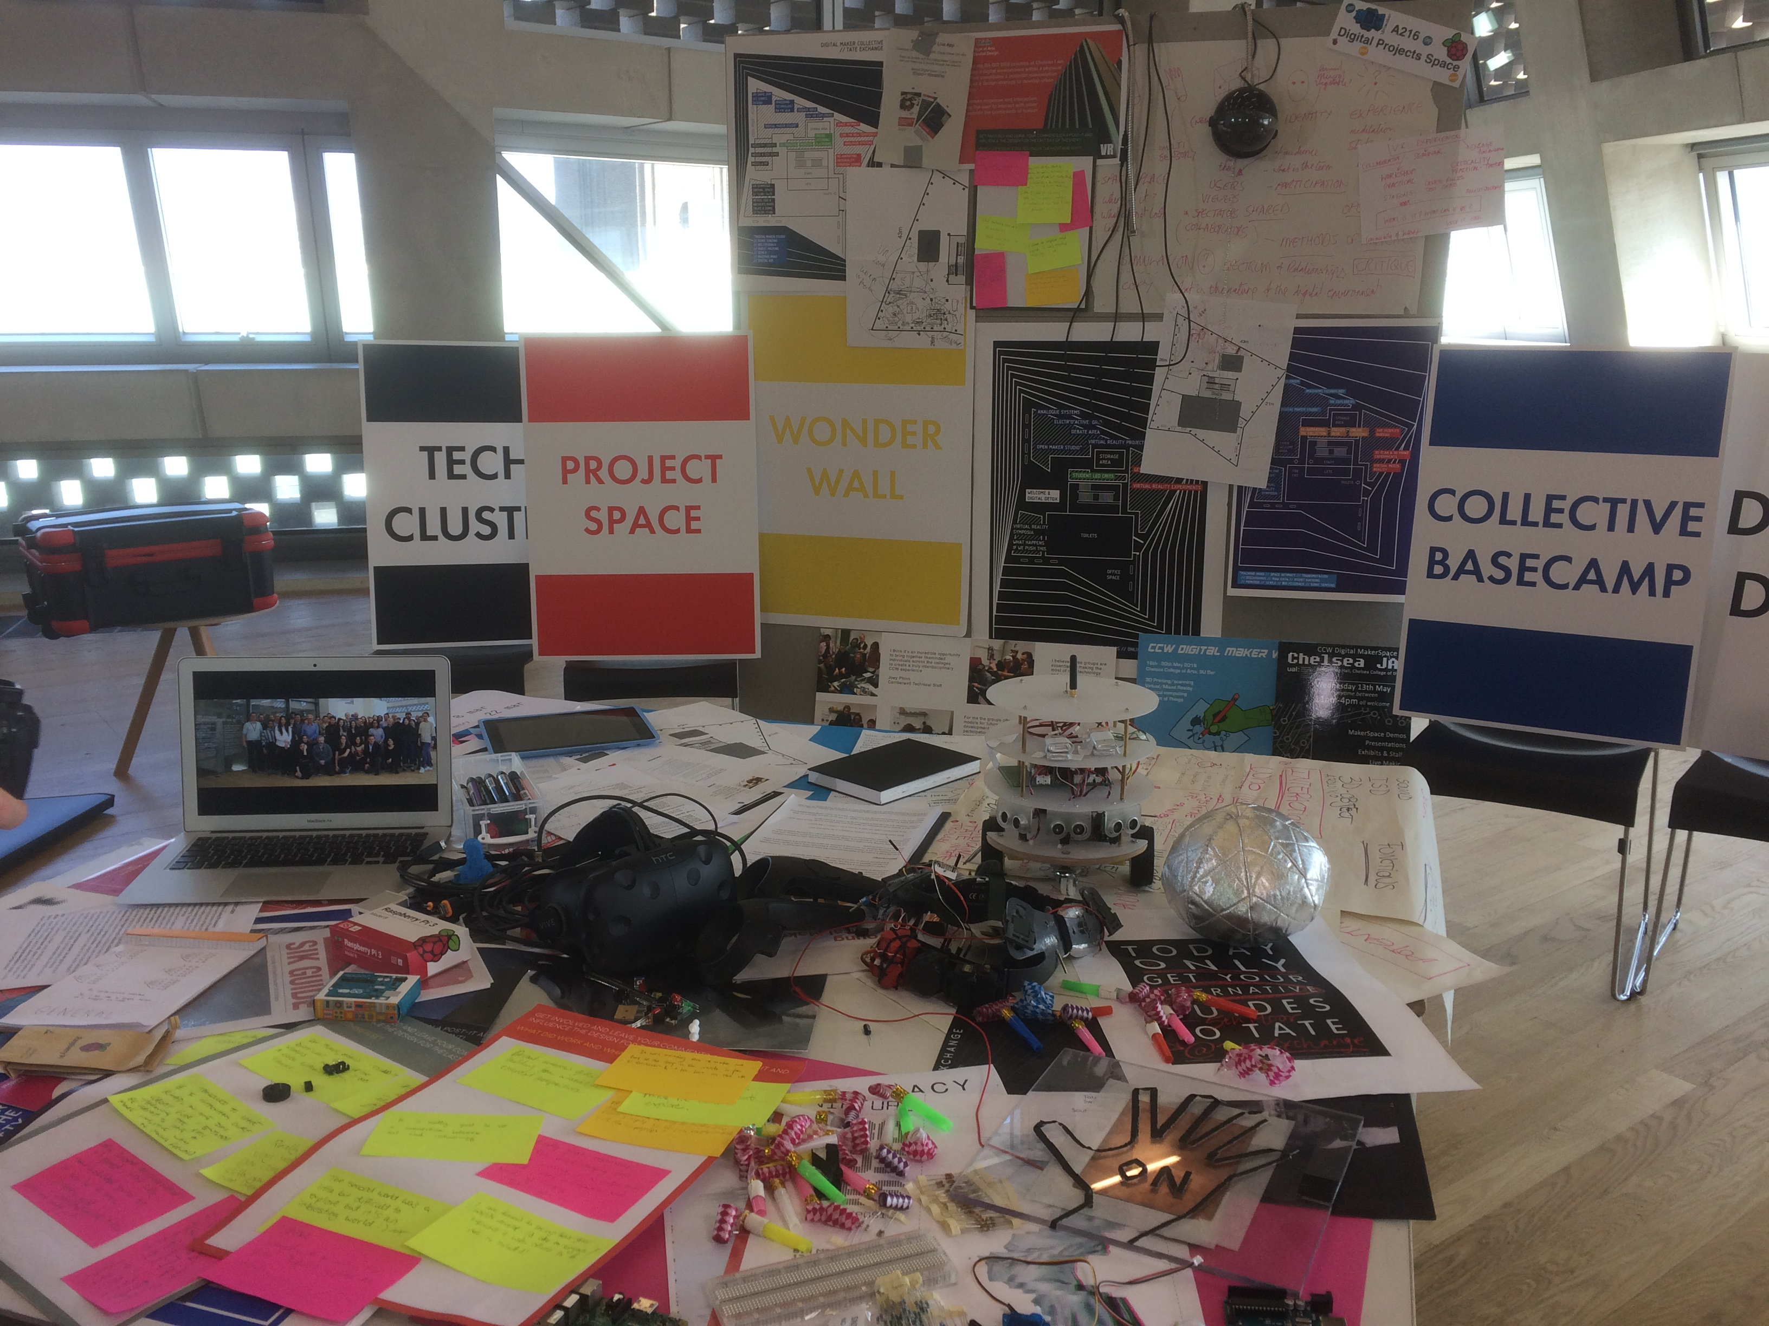
#artsDMC
Digital Making Unconference
Southwark Room @TateExchange
17 & 19 May 2017

Slide 15
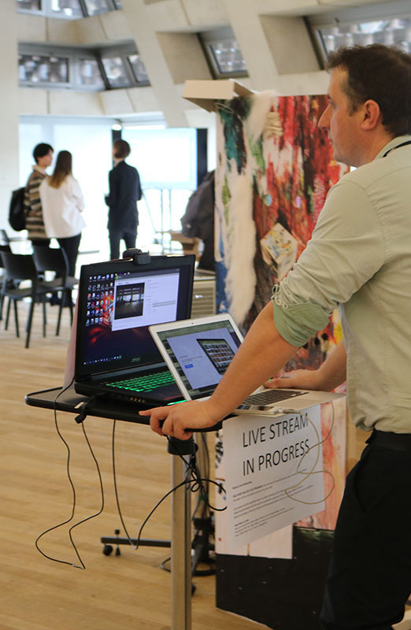
Thank You For Listening
Twitter: @CCWDigital & @UAL
Instagram: CCWDigital #artsDMC
http://digitalmakercollective.org/
https://process.arts.ac.uk/

